Slide 1


Slide 2

Christopher Shannon
Brian Del Carpio
Melvin Wong
Ian Wu
Simon Fraser University
CMPT 276

Slide 3
PROJECT OVERVIEW
Objective:
- Deliver an application to streamline the process of tracking workout schedules
- Bridge between Strava and Google Calendar
Technologies and Process:
- JavaScript/React, HTML, CSS
- Agile Kanban SDLC

Slide 4
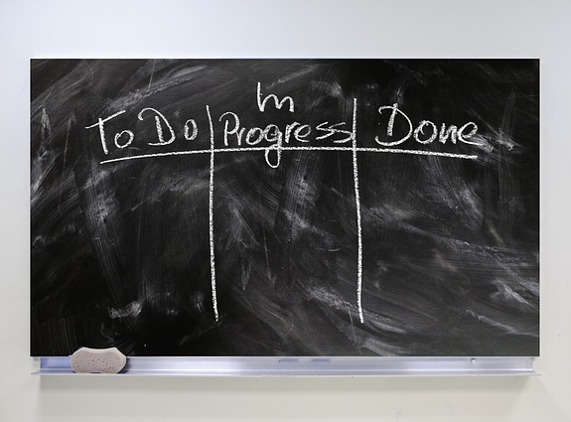
Benefits:
- Simplicity of use
- Flexibility
- Adaptability to unforeseen issues
Concerns:
- The project could get very complex
- “Never-ending list”
Board Columns:
- To-Do: list of tasks that need to be actioned
- In Progress: list of tasks currently being worked on
- Review: completed tasks waiting to be inspected
- Completed: tasks that passed inspection
SD/LC: KANBAN

Slide 5

GOOGLE CALENDAR API
1) Create Events in google calendar
2) Recall past Events
3) Store events title, date, time and description

Slide 6

STRAVA API
1) Create Events in Strava
2) Recall past Events
3) Store the events, date, time and descriptions

Slide 7
PROJECT FEATURES
Plan Future Workouts:
- user inputs date and time
- uploads to google calendar
See Upcoming Workouts:
- user receives list of date and times of upcoming workouts
Input Workouts:
- user inputs distance and duration of workout
- uploads to Strava
Recall Past Workouts:
- user receives list of past workouts date times

Slide 8

TECHNOLOGY STACK
JavaScript/React – Frontend library used to build interactive user interfaces
HTML – Markup language, structures web applications
CSS - Styles websites aesthetically
GitHub - Version Control Software

Slide 9
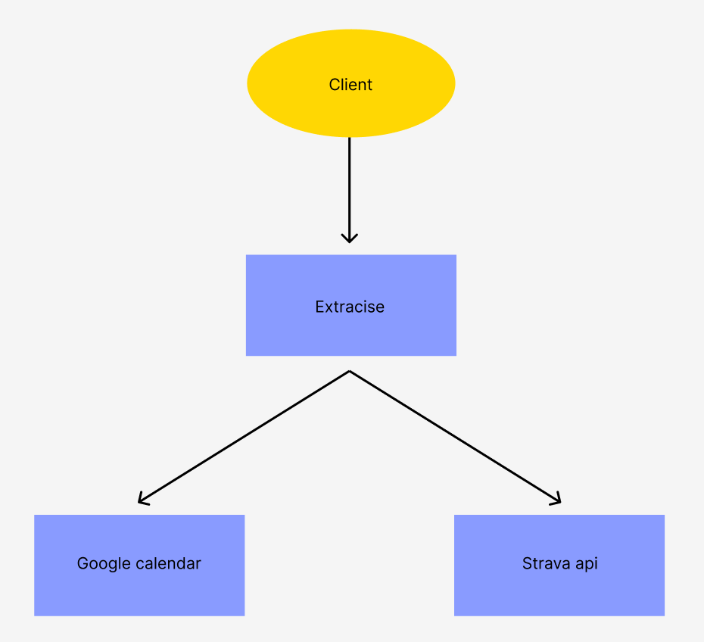
DFD LEVEL 0

Slide 10
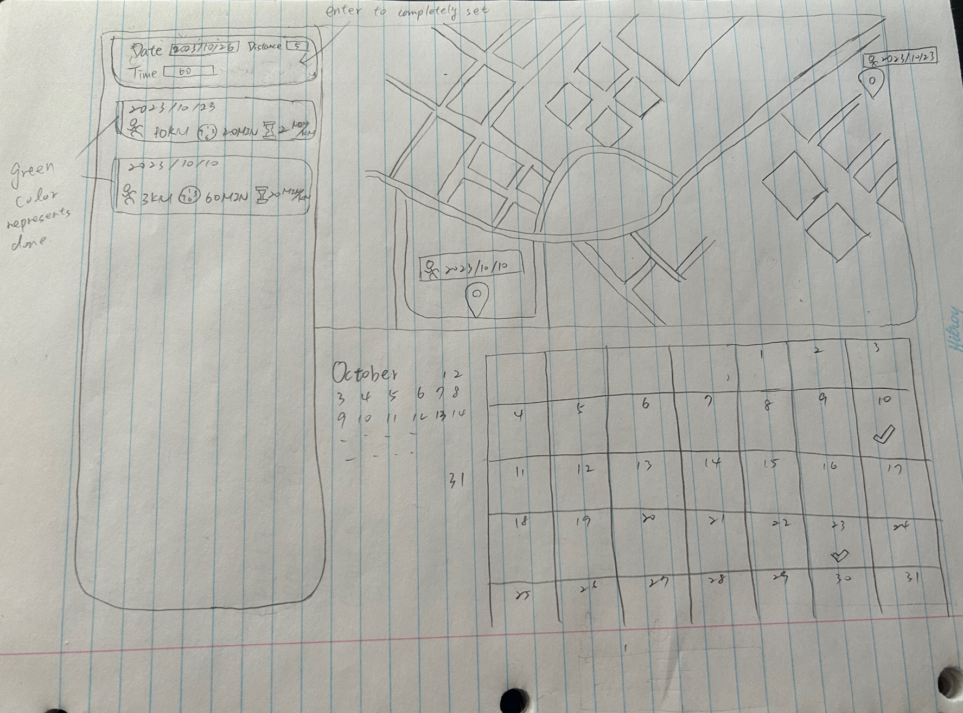
PROJECT SKETCH

Slide 11
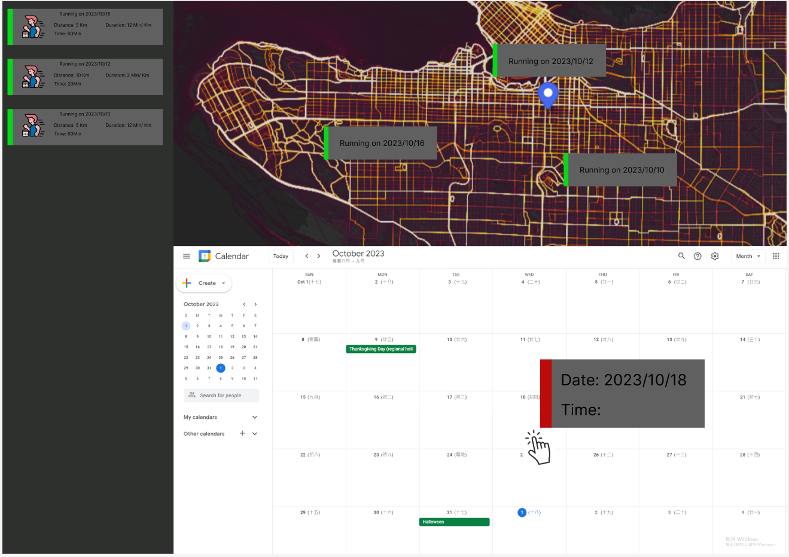
PROJECT PROTOTYPE

Slide 12
Thank you!

